Slide 1
Articles

Slide 2
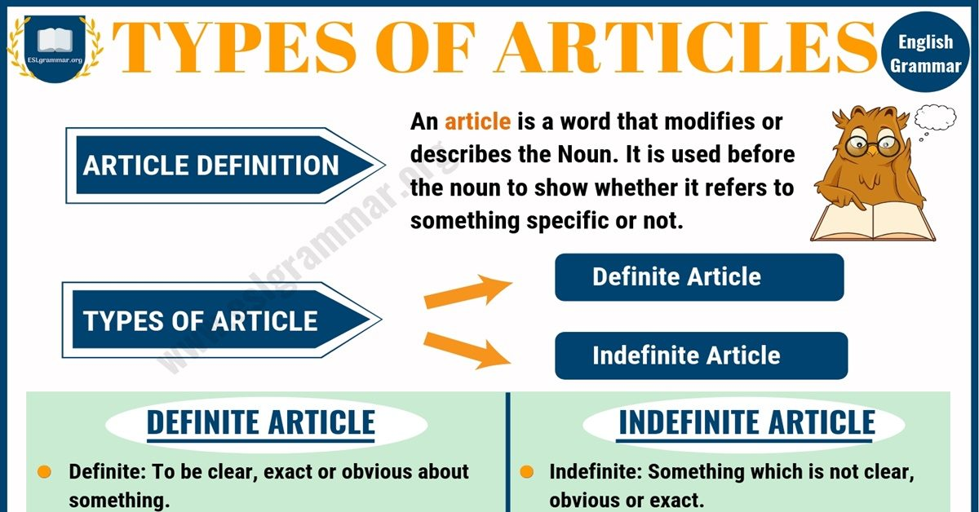

Slide 3
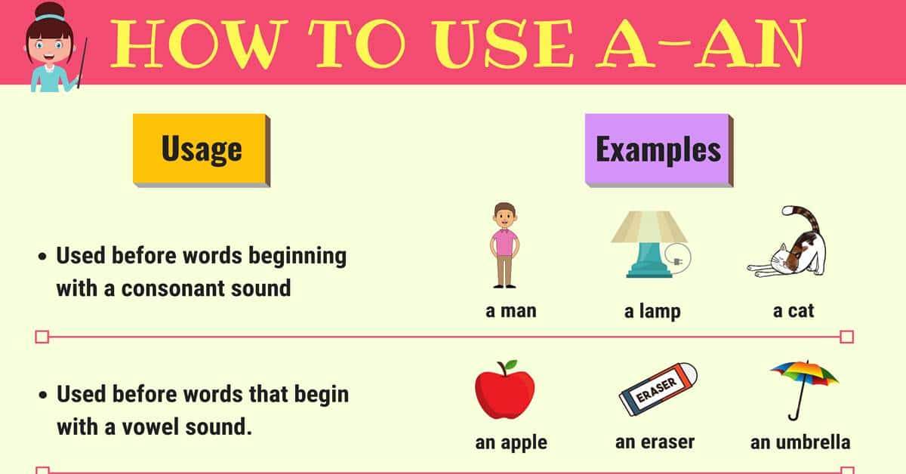

Slide 4
Rules for the use of the Indefinite article “A”

Slide 5
THREE BASIC USES OF INDEFINITE ARTICLE “a/an”
When you mention someone or something for the first time
Eg: I saw a rainbow yesterday
I consulted an optician yesterday
To show that someone or something is one of a group
Eg: It was a magnificent rainbow
He is an optician in London
When you say what someone’s job is
Eg: My mum is a nurse
Fred is a doctor

Slide 6
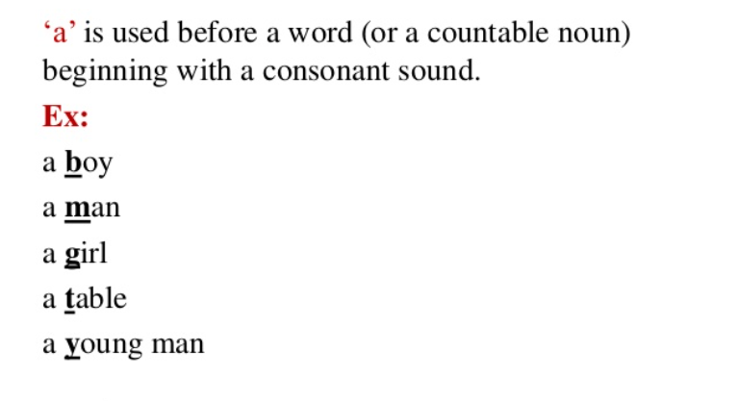

Slide 7
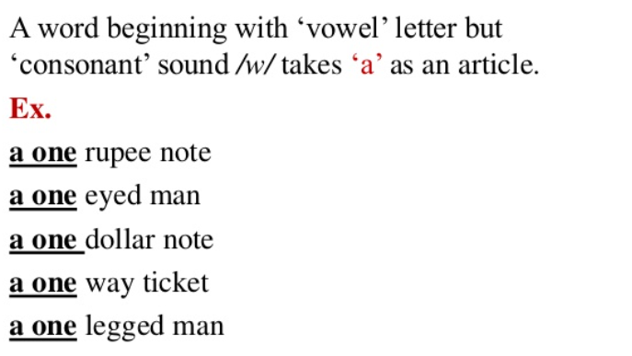

Slide 8
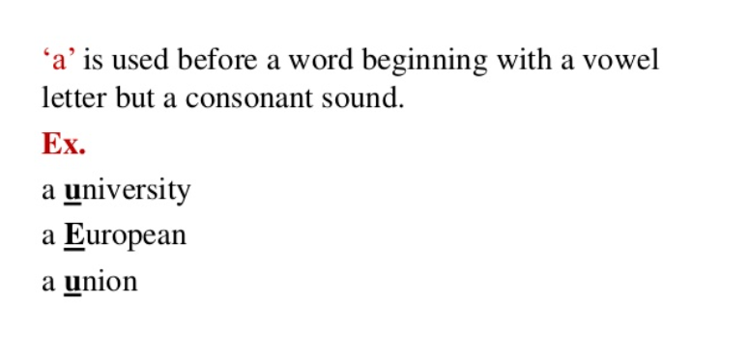

Slide 9
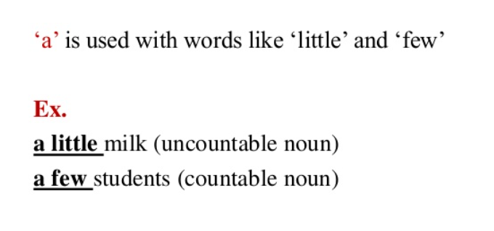

Slide 10
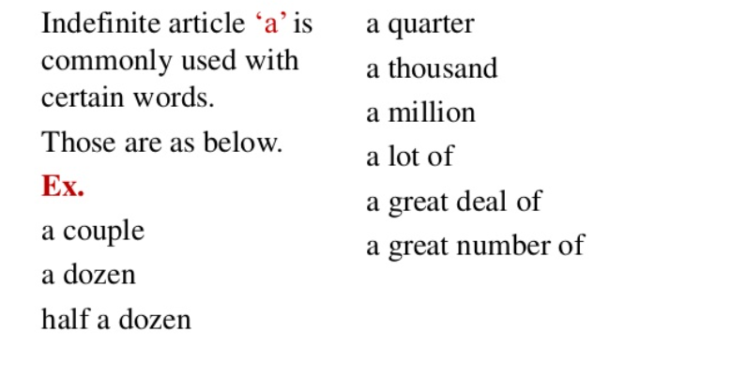

Slide 11
Rules for the use of the Indefinite article “An”

Slide 12
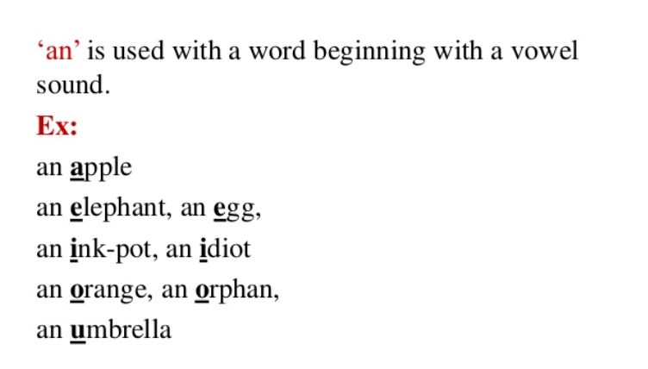

Slide 13
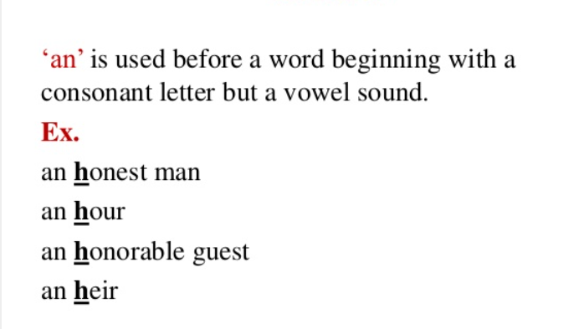

Slide 14
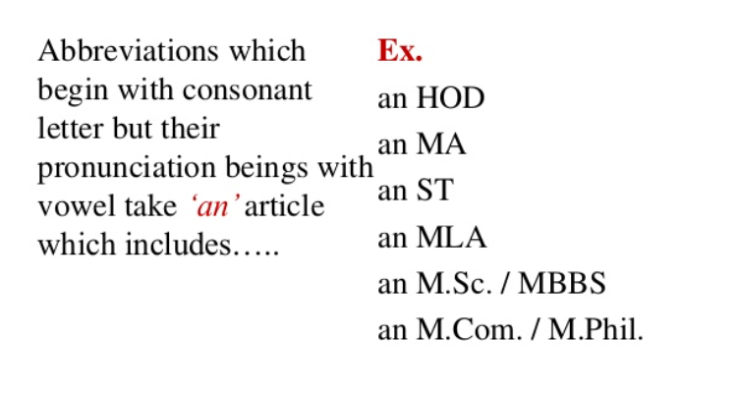

Slide 15
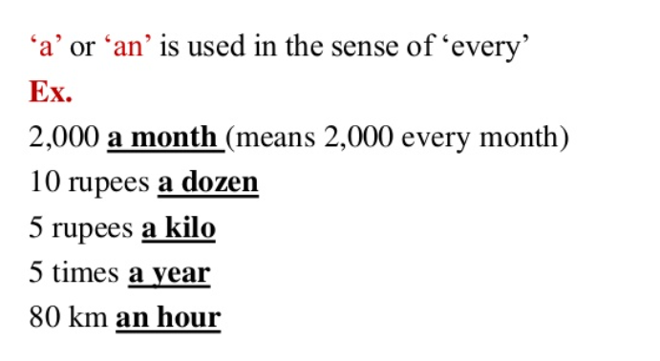

Slide 16
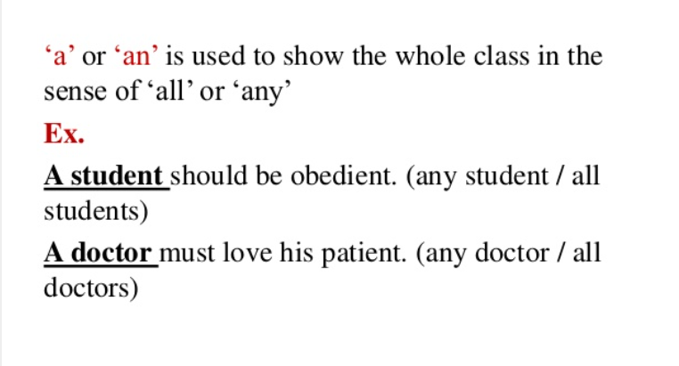

Slide 17
DON’TS OF A/AN
Do not use a/an with uncountable nouns like “rice, milk, cherries, information” etc.
Eg: He gave me an advice ( incorrect usage)
He gave me some advice.
Do not use a/an with plural nouns
Eg: I ate a cherries yesterday ( incorrect usage)
I ate some cherries
We use “the” before uncountable and plural nouns
Eg: The rice was delicious.
The cherries were tasty.

Slide 18
Rules for the use of the definite article “THE”

Slide 19
TO TALK ABOUT SPECIFIC PERSON OR THING
The book you want is out of print
Let us go to the park
The girl cried

Slide 20
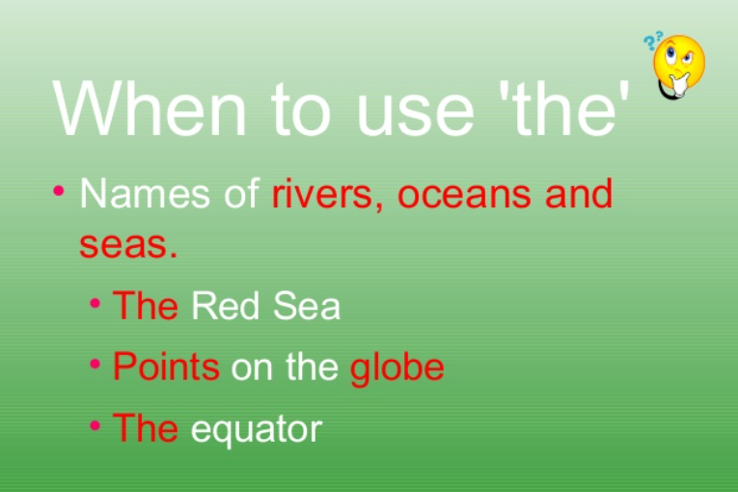

Slide 21
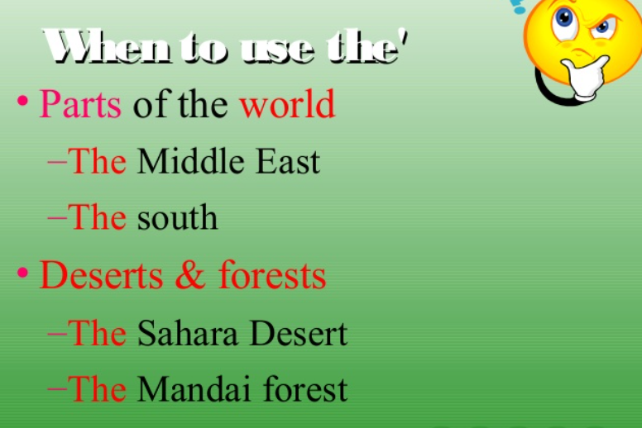

Slide 22
Before musical Instruments
Before musical Instruments ( in British English not in American English)
Eg: He can play the flute
They know to play the violin
With adjectives used as nouns
Eg: The rich are unhappy.
We gave food to the elderly.
With superlative adjectives
Eg: Mt. Everest is the highest mountain peak
Before unique things
The sun, the moon, the earth.
With newspapers
I read the Hindu/ the Herald Tribune
With well known buildings, historical places work of art and families an
Eg: the Taj Mahal, the High Court, the Secretariat the Mona Lisa, the Simpsons

Slide 23
notes
How to pronounce the article ‘the’?
Pronounce it as /ðə/ (thuh) before all consonant sounds including
/j/ (you), /w/ (we), and /h/ (he)
Eg: The book, the door, the hotel, the week, the yellow purse
Pronounce it as /ði:/ (thee) when the next word begin with a vowel sound:
Eg: the apple, the orange, the ice-cream, the umbrella, the interest.

Slide 24
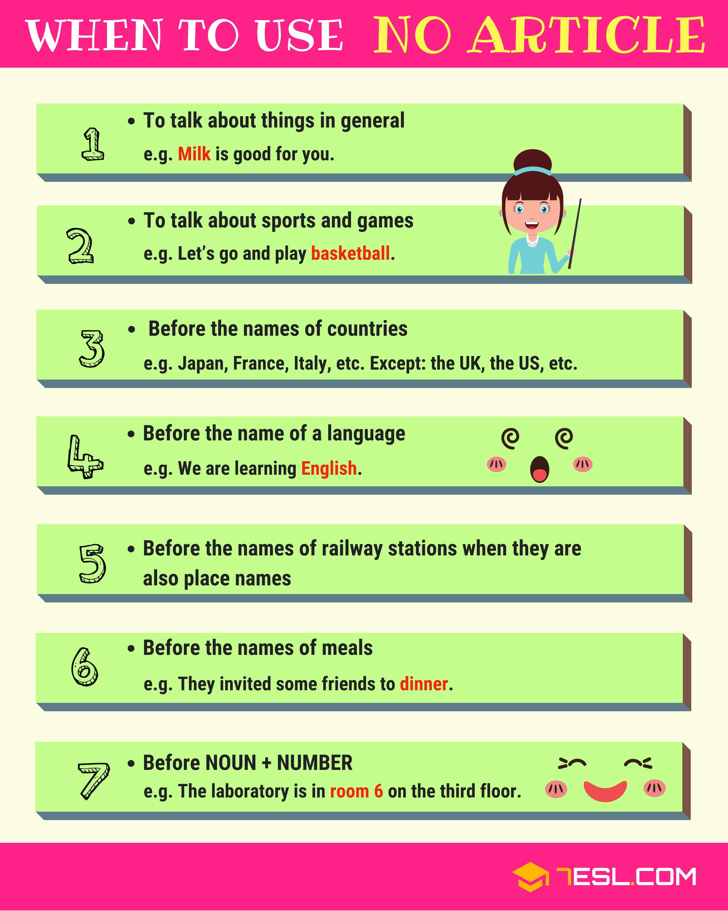

Slide 25
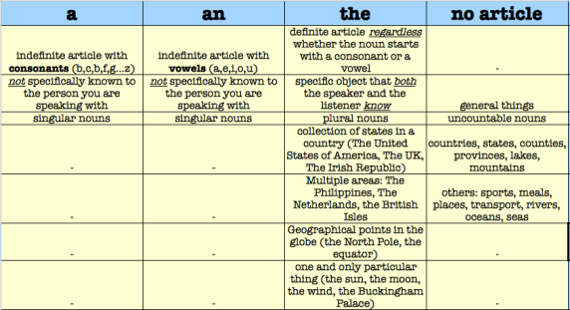

Slide 26
Fill in the blank with the appropriate article, a, an, or the, or leave the space blank if no article is needed:
1. He is _____ one eyed man.
2. ____ church on the corner is progressive.
3. Miss Lin speaks ____ Chinese.
4. She has decided to study _____ Political Science
5. One of the students said, "____ professor is late today."
6 Eli likes to play ____ volleyball.
7. The members of _____NATO rejected the idea.
8. My daughter is learning to play ____ violin at her school.
9. He has been to ______jail for ______second time.
10. Is your phone number 7832? No, there is _____ ‘1’ before _____‘8’.

Slide 27
Use the correct Articles
1. Copper is ___ useful metal
2. He is not ____ honourable man
3. Do you see ____ blue sky?
4. I first me him ___ year ago
5. Honest men speak ____ truth
6. she is ____MA graduate
7. Yesterday ____ European called me at the office
8. Is there _____’I’ your name.
9. I have been to _______Europe.
10. ____Ganga is _____ sacred river
11. I have _____ news for you.
12. These are ______ oranges you bought yesterday.

Slide 28
Thank You!

